Slide 1
Lead
Generation
Proposal
To:
Steven Hernandez

Slide 2
Lead
Generation
Process

Slide 3
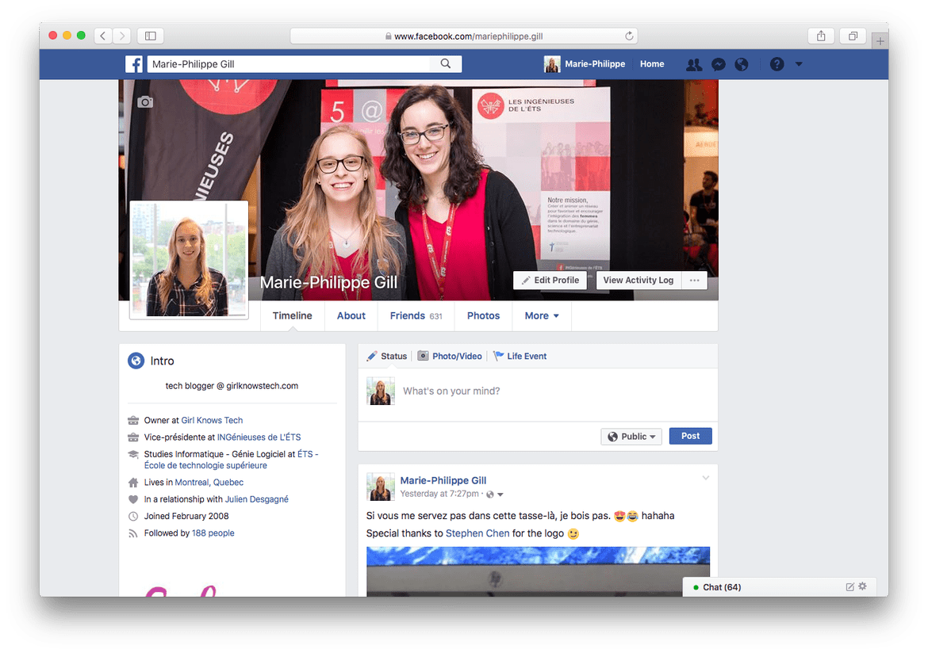
Facebook Profile
Clean up and make it professional, new images,
excited happy

Slide 4
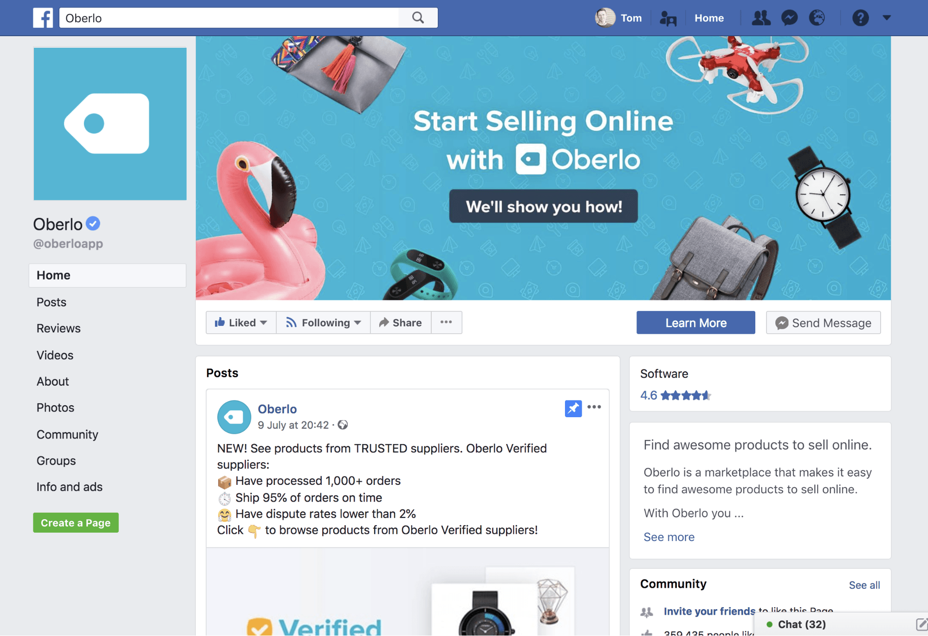
Facebook Business Page
Increase your following by driving organic traffic
From personal onto business page.

Slide 5
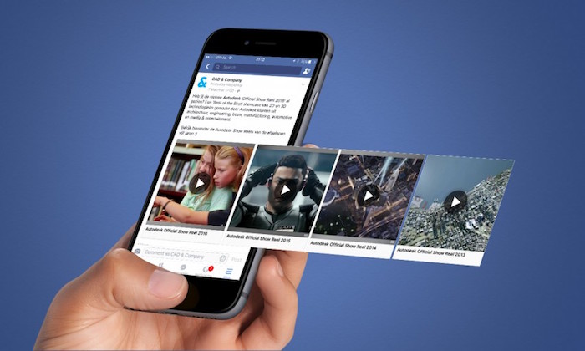
Video Strategies
Record between 3-7 videos one day that will
Cut into small segments to create content for
the entire month and more!

Slide 6

Facebook Live

Slide 7

Partnership

Slide 8
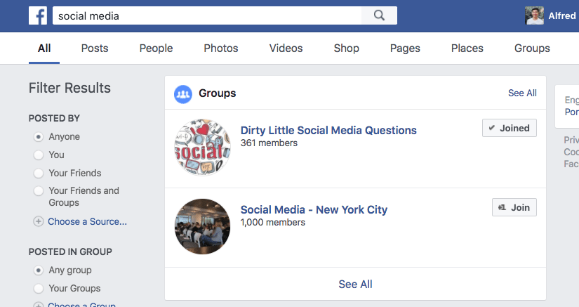
Facebook Groups

Slide 9
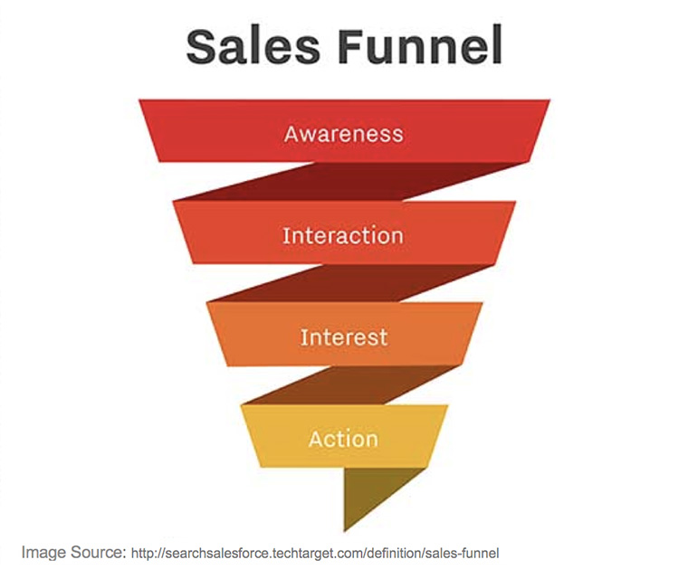
Sales Funnel
Create a funnel for people who are interested
In buying home but haven’t yet gotten
prequalified

